Slide 1




Data sources for feed balance modelling
Presentation for Resilient African feed and fodder systems project— 2nd national feed inventory landscape and capacity building workshop
October 28, 2024
John Mutua

Slide 2
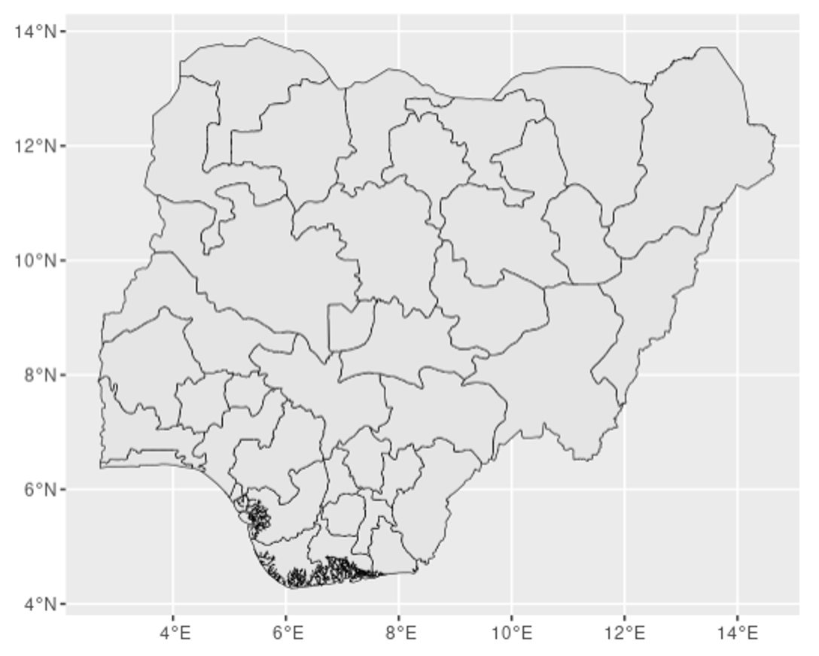
Administrative boundaries
For aggregating data
Levels
1,2,3
Source: GADM https://gadm.org

Slide 3
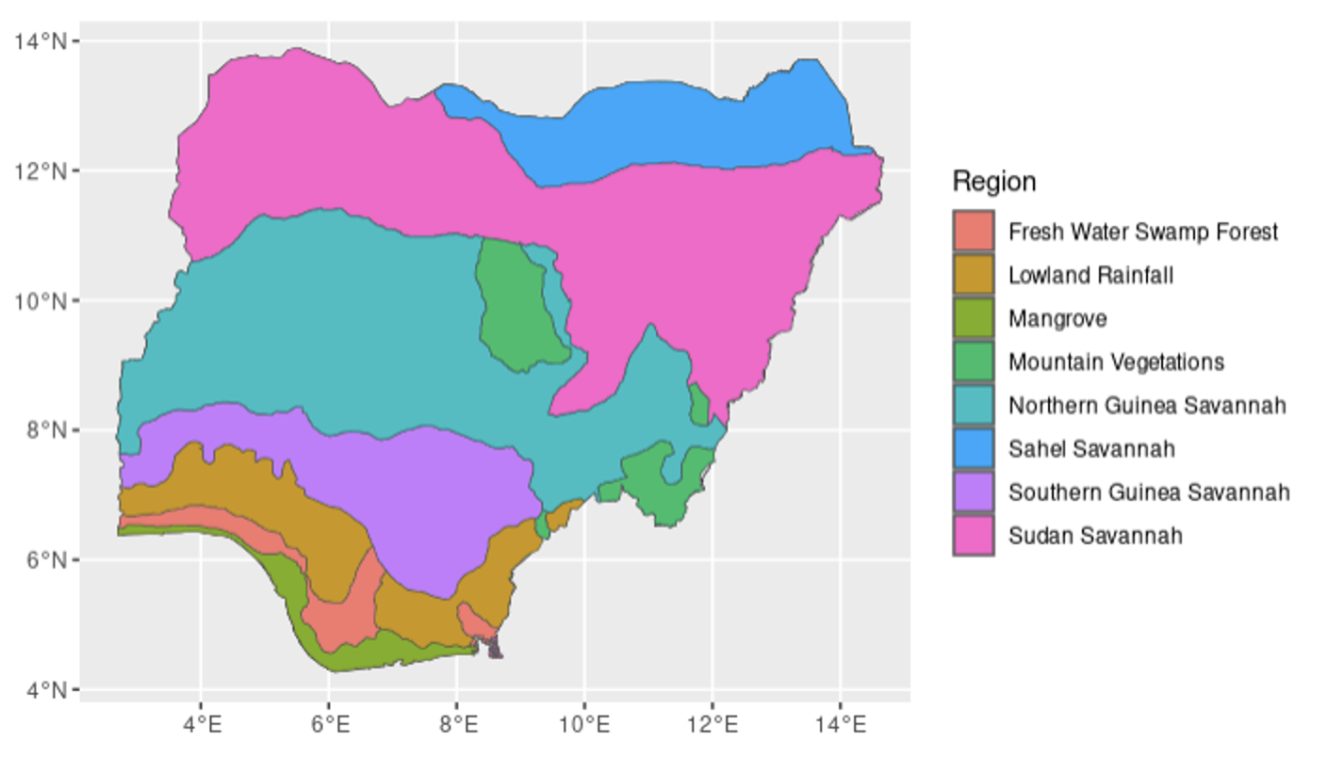
Aggregation zones
For aggregating data
Types
Agro-ecological zones
Livelihood zones
Source: Government ministry

Slide 4
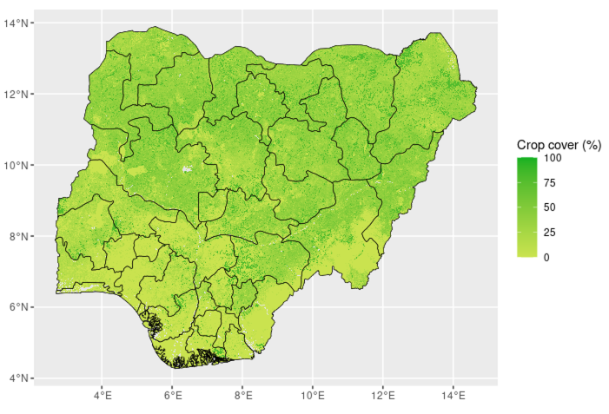
Land cover/use
Attribute total DMP to pastureland and cropland (feedable crops)
Land uses:
Natural grass
Cropland
Crop types?
Source: Copernicus https://land.copernicus.eu/en

Slide 5
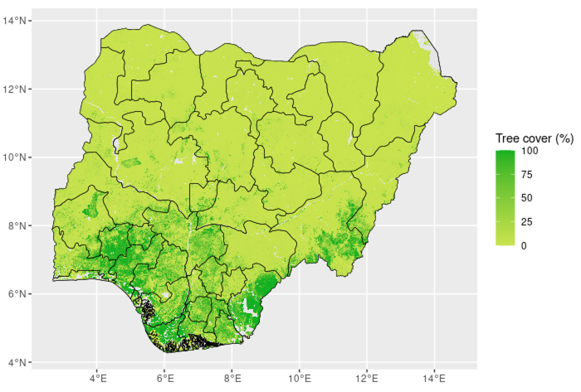
Tree cover
Allocating dry matter production
Proportion of natural grass in forest land?
Source: Florian et al. (2023) https://doi.org/10.1038/s41467-023-37880-4

Slide 6
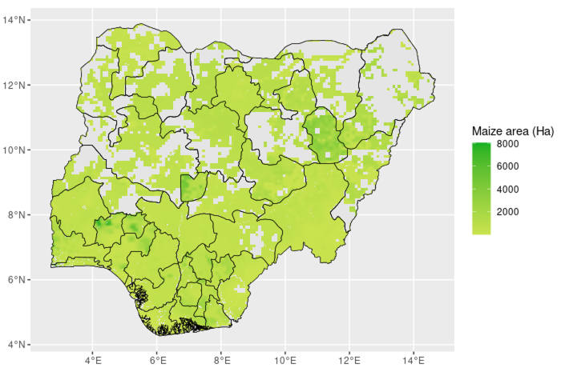
Crop area/type
Allocating dry matter production to crop types
Extracting feedable crop residue
Source: SPAM https://mapspam.info

Slide 7
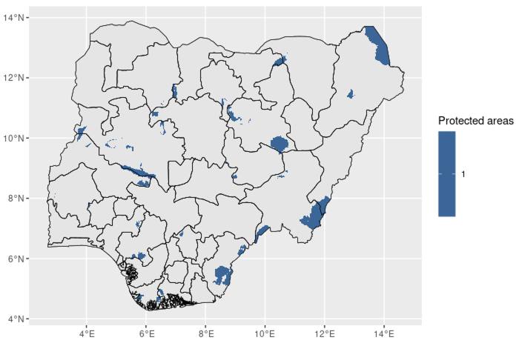
Protected areas
Masking out restricted areas
Source: WDPA https://www.protectedplanet.net/en

Slide 8
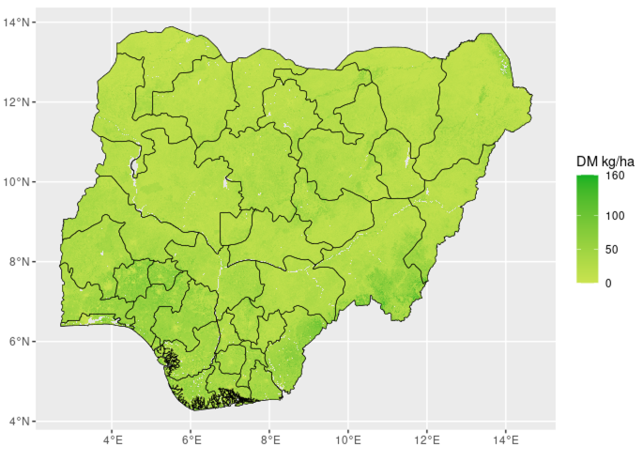
Dry matter productivity
Above-ground dry matter production
Dry matter from cultivated forages and concentrate feeds estimated based on government statistics, reports
Source: Copernicus https://land.copernicus.eu/en

Slide 9
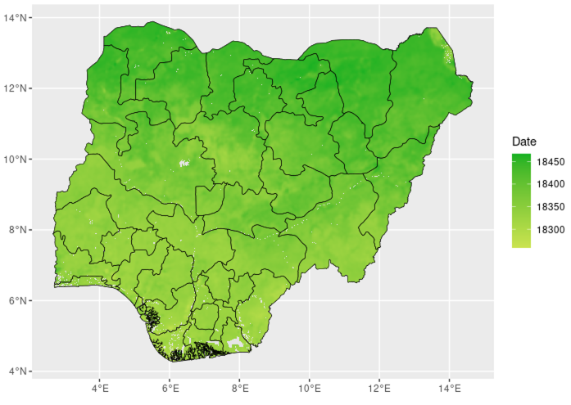
Phenology
Extracting start/end of seasons
Source: MODIS https://lpdaac.usgs.gov/products/mcd12q2v006

Slide 10
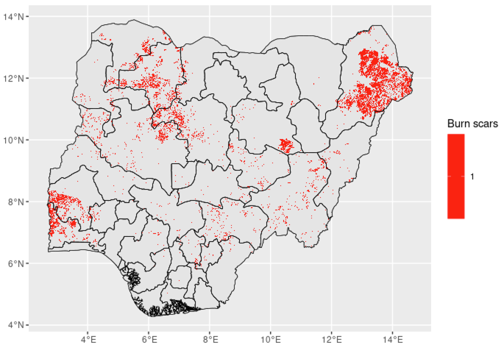
Burned areas
Areas with burn scars, biomass is not available for feeding
Source: Copernicus https://land.copernicus.eu/en

Slide 11
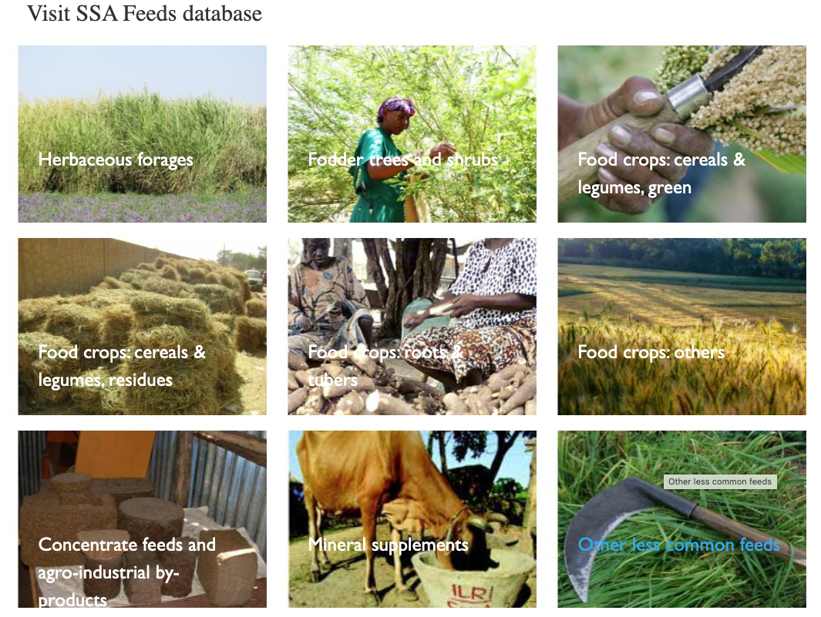
Feed parameters
ME, CP values for various feed items
Sources: SSA feed database https://feedsdatabase.ilri.org, published articles, Feedipedia https://www.feedipedia.org

Slide 12
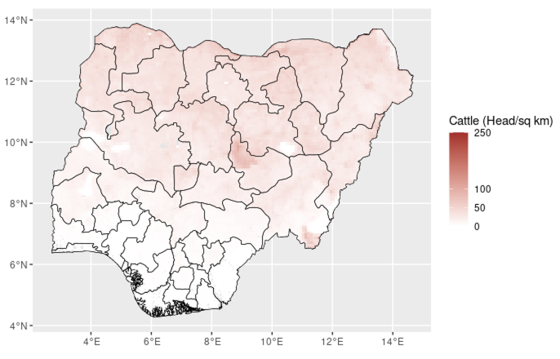
Livestock population
Calculating livestock energy requirements by species
Source: FAO https://www.fao.org/livestock-systems/global-distributions/en

Slide 13
Livestock parameters
Sourced from experts, online databases
Include:-
Live weight
Daily weight gain
Fertility rate
Lactation length
Daily milk yield
Maximum daily milk production
Annual milk yield
Daily walking distance

Slide 14
Thank you

